Slide 1


DEPARTMENT OF COMPUTER SCIENCE AND ENGINEERING
Autonomous Upscaling Reinforcement Agents
Guide : Dr. Sheena Kurian K
Date : 31/03/2026
Team Members:
Vaishnav S Nair MUT22CS146
Eric Thomas MUT22CS056
Pranav R Mallia MUT22CS116
Navaneet Krishna MUT22CS104

Slide 2
INTRODUCTION
This project introduces a cooperative, multi-agent reinforcement learning system designed to over-come the high costs and poor performance associated with uncoordinated microservice autoscaling.
Autonomous Upscaling Reinforcement Agents

Slide 3
PROBLEM STATEMENT
“Traditional cloud auto-scalers operate on a per-service basis using simple metrics, leading to inefficient resource utilization, high operational costs, and poor performance under dynamic loads. "

Slide 4
OBJECTIVES
The main 4 goals of the Aura System are the following:
Design and engineer a distributed autoscaling architecture with a focus on Multi-Agent Reinforcement Learning (MARL) in which individual microservices are managed by different intelligent agents.
Design a synergically reward structure that brings together three critical aspects:- operational cost optimization, service quality metrics (including response time and processing capacity),and infrastructure stability.
Improve agent accuracy and robustness through training with high-fidelity Kubernetes simulation platform before deployment, adhering to the Centralized Training with Decentralized Execution (CTDE) framework.
Assess and validate AURA’s effectiveness by comparing against Kubernetes’ own Horizontal Pod Autoscaler (HPA) system.

Slide 5
EXISTING SYSTEMS
Existing Work
Methodology
Advantages / Contribution
Firm
Mao et al., 2016
Deep Reinforcement Learning (DRL)
Pioneer work showing DRL can outperform threshold-based rules for VM allocation.
AWARE
Wang et al., 2018
DRL with Workload Prediction
Combines an LSTM for predicting future workload with DRL for proactive scaling decisions.
AWARE
Malla et al., 2020
Hierarchical RL
Uses a two-level RL system to manage both function placement and instance counts in serverless.
FIFER
Giménez et al., 2022
Q-Learning + Prediction
Enhances Kubernetes HPA with Q-learning and workload prediction for web apps.
SPE-HPA
Yan et al., 2020
Transfer Learning + DRL
Pre-trains a DRL model on various workloads so it can adapt to new apps quickly.
DeepScale
Zhang et al., 2021
Hybrid RL (Model-based & Free)
Combines learning a system model with direct RL to improve sample efficiency.
H-Scale
Boden G. et al., 2023
Graph Neural Networks + DRL
Models microservice topology as a graph to make more informed scaling decisions.
Kube-Knots

Slide 6
OVERVIEW OF THE SYSTEM
The core idea behind AURA is to allow each microservice to learn how its scaling decisions influence not only its own performance but also the performance of neighboring microservices within the application graph. Since modern microservice architectures often involve tightly coupled communication chains (e.g., frontend -> API gateway -> authentication -> database), scaling a single service in isolation may result in bottlenecks or cost inefficiencies. AURA addresses this limitation by encouraging coordinated scaling policies derived from shared learning experiences.

Slide 7
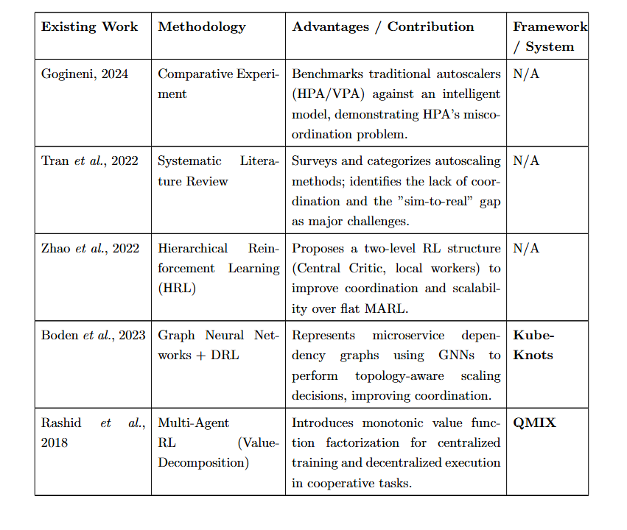
LITERATURE SURVEY

Slide 8
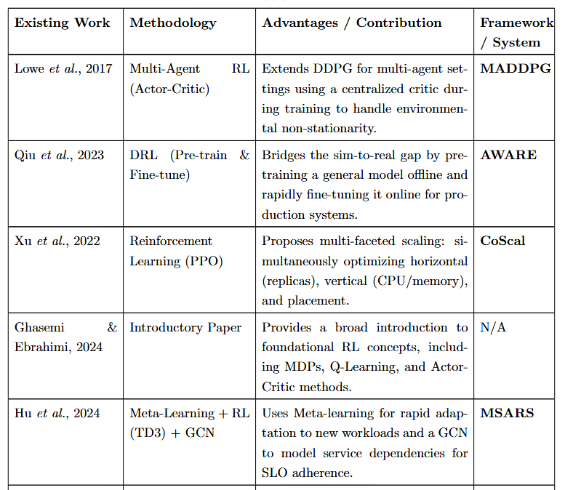

Slide 9
INFERENCES FROM LITERATURE SURVEY
Gogineni, 2024 Demonstrates that traditional autoscalers like HPA suffer from miscoordination, as services scale independently without considering dependencies.
Tran et al., 2022 Identifies key research gaps: lack of inter-service coordination and the sim-to-real gap in autoscaling solutions.
Zhao et al., 2022 (HRL) Introduces a hierarchical RL framework with a central critic and local agents for better scalability and coordinated decision-making.
Boden et al., 2023 (Kube-Knots) Uses Graph Neural Networks (GNNs) with DRL to model microservice dependencies and enable topology-aware autoscaling.
Rashid et al., 2018 (QMIX) Proposes value decomposition for multi-agent RL, enabling centralized training and decentralized execution in cooperative systems.
Notes:
11

Slide 10
6. Qiu et al., 2023 (AWARE) Addresses the sim-to-real gap using offline pre-training + online fine-tuning for practical deployment in real systems.
7. Xu et al., 2022 (CoScal) Introduces multi-dimensional autoscaling (horizontal, vertical, placement) using PPO for improved resource optimization.
8. Ghasemi & Ebrahimi, 2024 Provides foundational understanding of RL concepts like MDPs, Q-learning, and Actor-Critic, supporting advanced approaches.
9. Hu et al., 2024 (MSARS) Combines meta-learning, RL (TD3), and GCNs to achieve fast adaptation and SLO-aware coordinated autoscaling.
10. Lowe et al., 2017 (MADDPG) Extends actor-critic methods to multi-agent settings using a centralized critic to handle environment non-stationarity.
Notes:
11

Slide 11
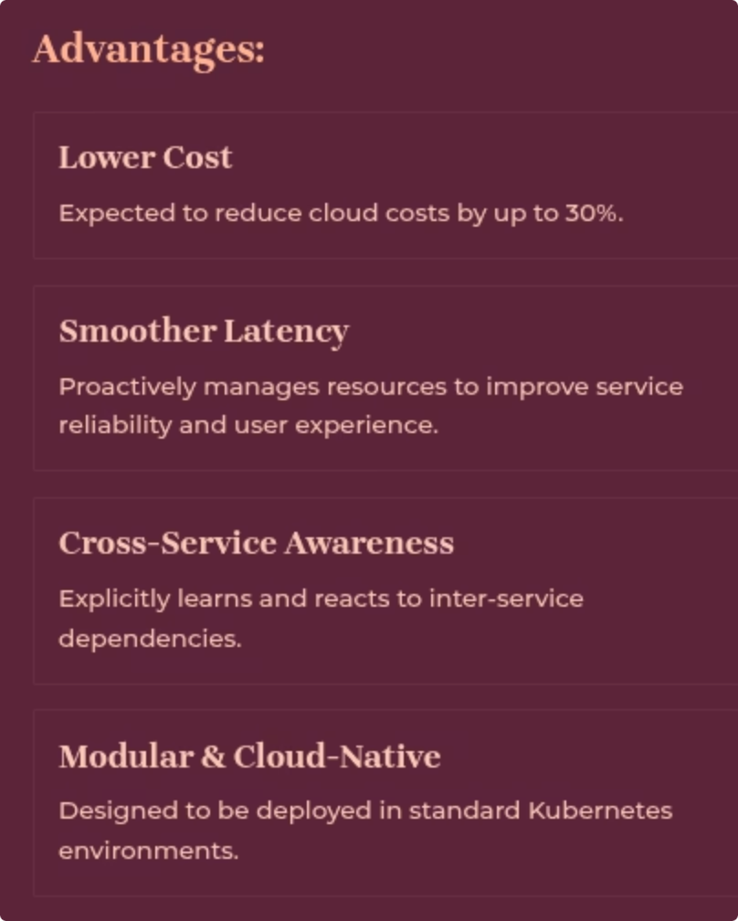
PROPOSED SYSTEM
Multi-Agent Autoscaler (AURA): We treat each microservice as an intelligent agent that makes its own scaling decisions.
Cooperative Learning via QMIX/MADDPG: Agents learn to coordinate their actions to optimise a shared, system-wide objective.
Centralised Training, Decentralised Execution: A shared reward and critic are used during offline training to promote cooperative behaviour, whilst agents act independently in the live environment.

Slide 12

SYSTEM ARCHITECTURE
The system architecture is structured around two distinct cycles, an offline training pipeline for the generation of sla policies and an online control loop for the decentralized execution and implementation of these learned policies. These cycles are supported by a unified monitoring and storage stack. The architecture has 5 components working together:
• Traffic Generator (Locust): a locustfile.py which simulates realistic traffic, generates load which are from different user personas. For example, there could be a web user who is just our site to just simple browser and there will be other users who add stuff to their cart.• Microservice Environment: Could be a 3 tier micro-serviced app, such as a frontend, backend and a database. All of these microservices are containerized and ran as pods, there is also a central pod agent.
• Monitoring & Storage Stack: we use Prometheus as the metrics endpoint in our web-site. Prometheus basically sends data such as CPU usage, network bytes transmitted etc. Grafana is used for visualization of these data which is generated by Prometheus.
• Offline Training Pipeline: It is a simulation environment which is used for the agent to learn. It has a simulator, a petting Zoo , a QMIX Trainer and an Experiment Runner.
• Online Control Plane: This one makes decisions in real time. Performs Policy inference using trained policy and also the live metrics, which is then validated via a safety module

Slide 13
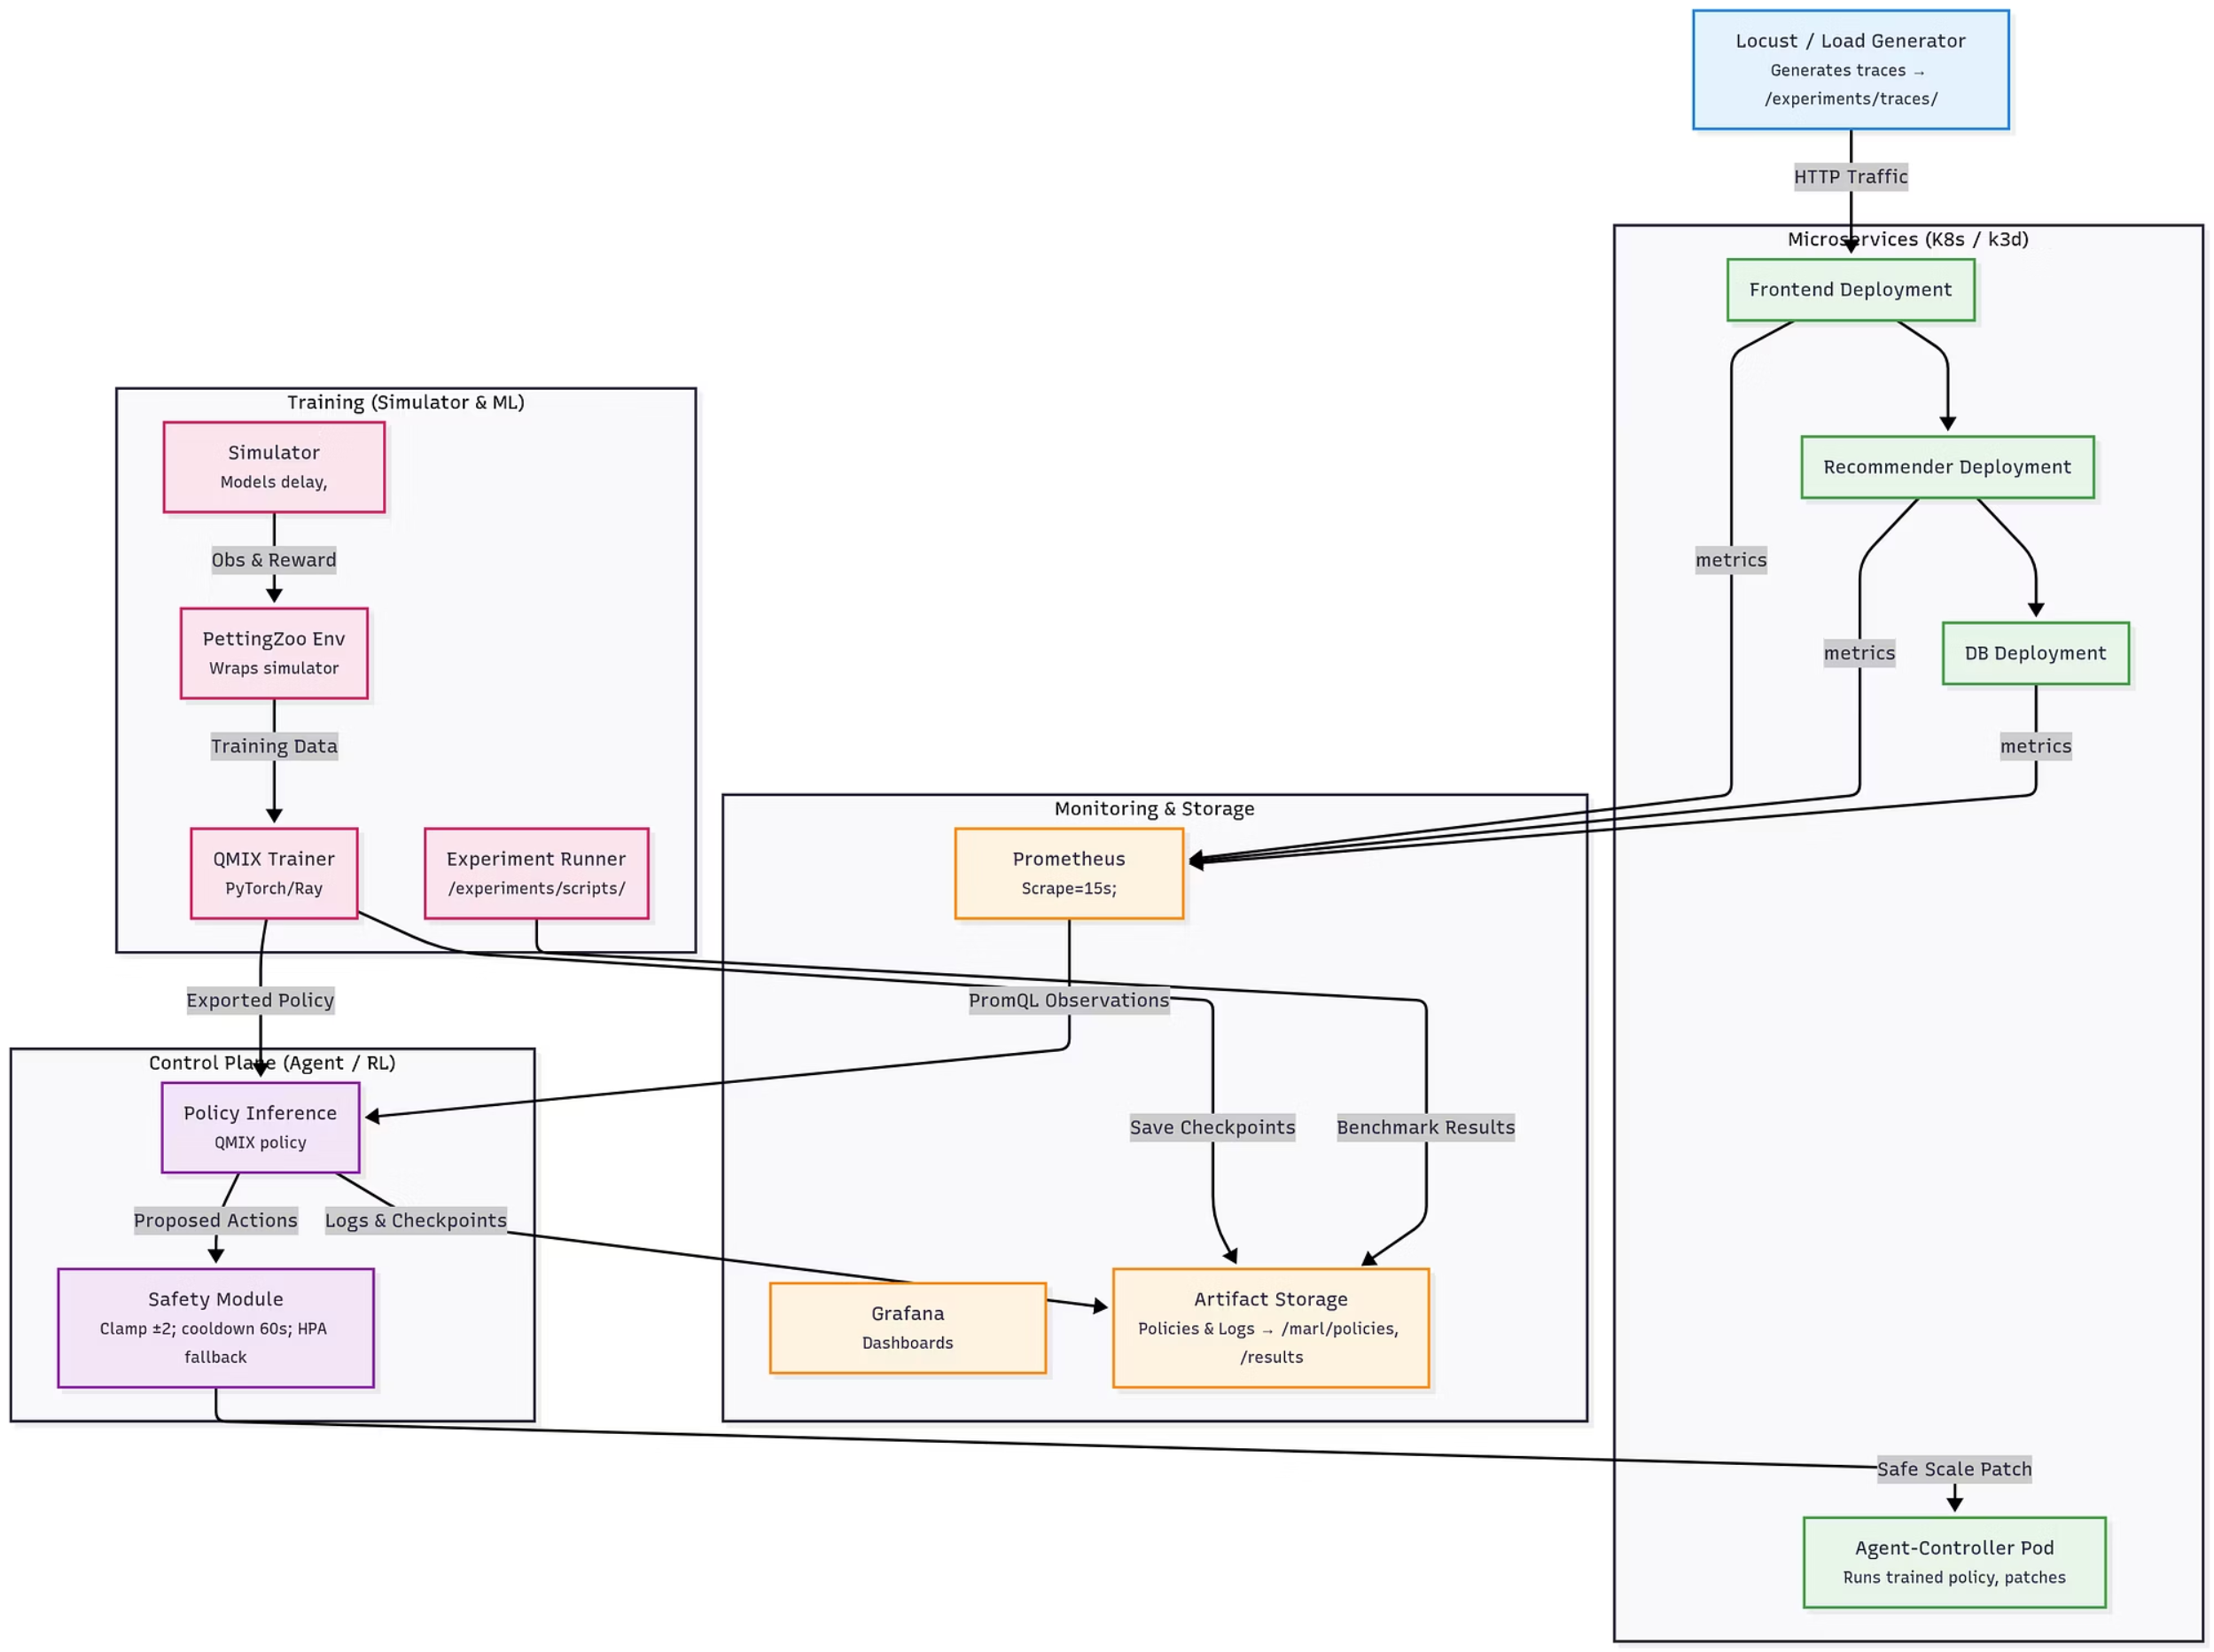
System Architecture

Slide 14
ALGORITHM
Algorithms (1/2) - Baseline: Kubernetes HPA
Baseline 1: Kubernetes Horizontal Pod Autoscaler (HPA)
Mechanism:
The HPA is the default, industry-standard autoscaler in Kubernetes.
It operates as a simple, reactive control loop.
Periodically (default: 15s), it checks the average value of a specified metric (most commonly CPU utilization) across all pods in a deployment.
It then uses a simple ratio to calculate the desired number of replicas:
desiredReplicas = ceil[currentReplicas * ( currentMetricValue / desiredMetricValue )]

Slide 15
ALGORITHM
Strengths:
Simple, robust, and well-understood.
Effective for stateless applications with CPU-bound workloads.
Limitations (Why we need something better):
Reactive: It can only respond after a metric has crossed its threshold. It cannot proactively scale in anticipation of load.
No Inter-Service Awareness: An HPA on a frontend service has no knowledge of the downstream impact on the database. It can easily scale up the frontend, only to overwhelm the backend, causing a system-wide failure.
Single-Metric Focus: It struggles to balance multiple objectives (e.g., CPU, memory, and latency) simultaneously.
Research Context: Works like SPE-HPA (Giménez et al., 2022) attempt to improve the HPA by adding a predictive layer, but they still operate on a per-service, single-agent basis.

Slide 16
ALGORITHM
Baseline 2: QMIX for Cooperative Control
Why Multi-Agent RL?
A single-agent system, as seen in works like MSARS (Li et al., 2021), has to manage a massive, combined action space, which becomes intractable as more services are added.
A multi-agent approach is a more natural fit for microservice architectures, allowing each service to be controlled by a specialized agent.
The CTDE Paradigm: Centralized Training, Decentralized Execution
This is the core concept behind modern MARL algorithms like QMIX.
Decentralized Execution (Live Deployment): During operation, each agent makes its own decisions using only its local observations (CPU, latency, etc.). This is fast, scalable, and does not require a central controller.
Centralized Training (Offline Simulation): During the training phase, we use a centralized "mixing network" that has access to the global state (observations from all agents). This allows the system to learn how the joint actions of all agents affect the global reward, thus teaching them to coordinate.

Slide 17
ALGORITHM
Centralized Reward Function:
A single, shared reward scalar is calculated at each step and broadcast to all agents. This forces them to learn cooperative strategies.
The formula is a weighted sum of penalties:
Core Formula
r = - (α·cost_norm + β·sla_fraction + γ·flap_penalty)
α (Cost): 1.0. Penalizes the total number of running pod-hours.
β (SLA Violation): 10.0. A heavy penalty for the fraction of requests that exceed the p95 latency SLO. This is the primary driver of performance.
γ (Flapping): 2.0. A small penalty for frequent changes in replica counts to encourage stability.

Slide 18
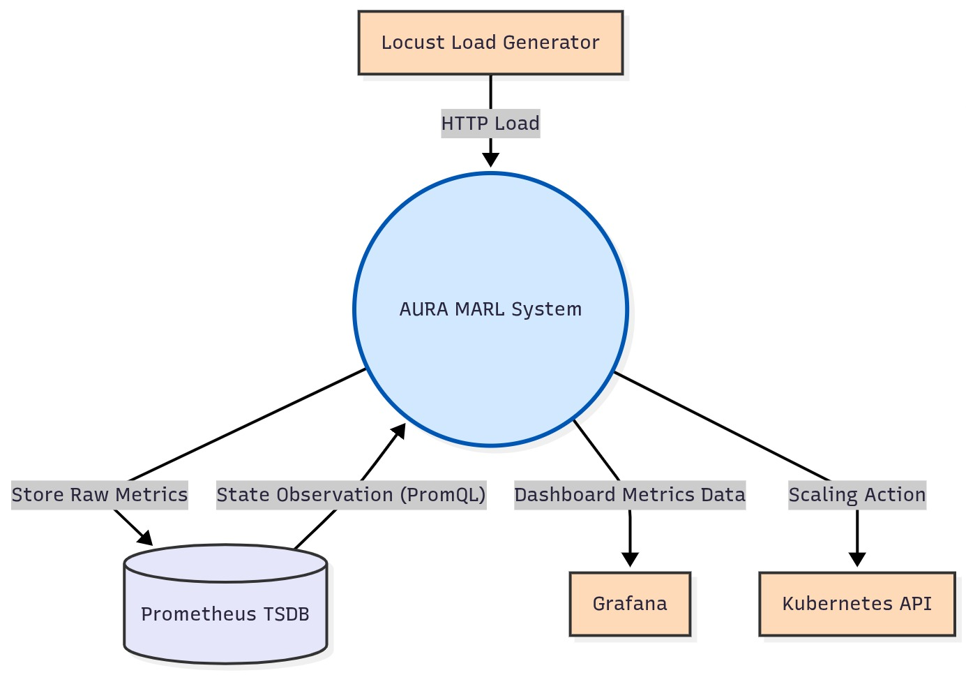
DFD LEVEL 0
Notes:
15

Slide 19
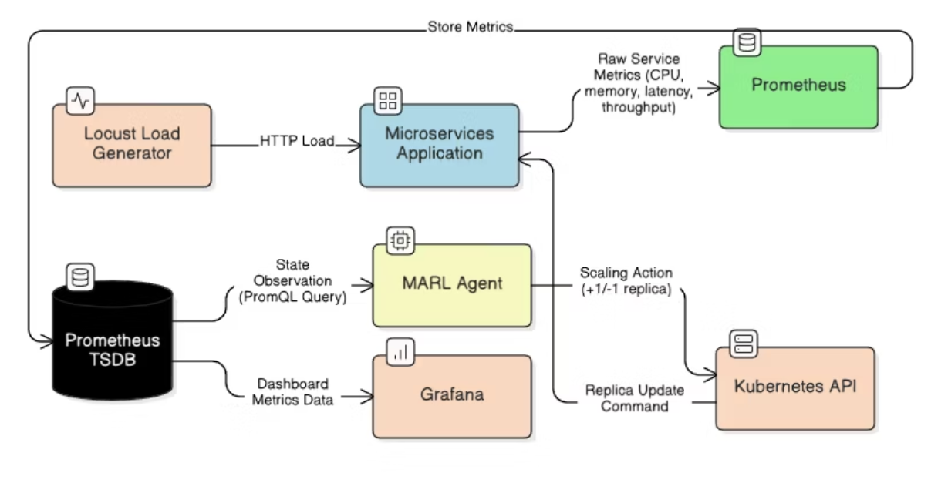
DFD LEVEL 1
Notes:
16

Slide 20
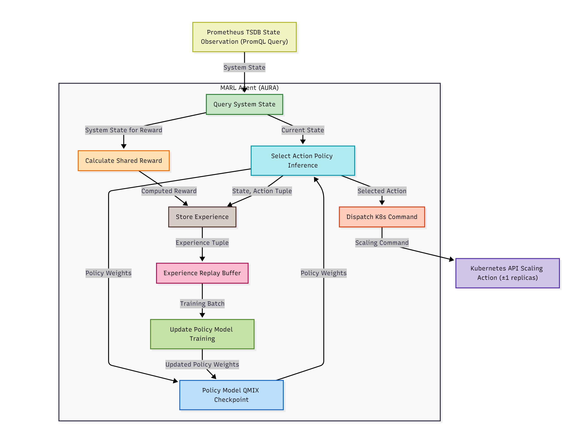
DFD LEVEL 2
Notes:
17

Slide 21
MODULES
Simulator
Digital twin of the Kubernetes environment Simulates pod startup delays, Prometheus lag Provides REST API endpoints /reset and /step
• Pod Startup Delays: Models the time (e.g., 10-45 seconds) a new pod takes to become fully operational and serve traffic.
• Monitoring Scrape Lag: Simulates the 15-second delay inherent in Prometheus, where metrics are not available in true real-time.
• Request Queueing: Implements a per-service queueing model to accurately simulate how latency propagates when a service is overloaded.
PettingZoo Environment
Converts simulator data into structured observations/actions Compatible with MARL libraries(e.g., Ray RLlib) Its core responsibilities are to:
Translate the raw, dictionary-based state from the simulator into a fixed-size, normalized Observation Vector for each agent (as defined in /marl/env/metrics˙contract.json).
Define the discrete Action Space for each agent (e.g., a set of integers from 1-10 representing the desired replica count).
Receive the centralized reward from the simulator and pass it, along with the observations and ’done’ flags, back to the RL Trainer.
Autonomous Upscaling Reinforcement Agents

Slide 22
MODULES
QMIX Trainer
• Core reinforcement learning module• Handles experience replay, TD-loss, and network updates
• Outputs trained policy checkpoints (.pt) and TensorBoard logs4.3.4 Agent-Controller
• Runs inside Kubernetes as a lightweight control pod• Fetches metrics → infers actions → validates → scales pods
• Uses PromQL for querying Prometheus• Interfaces with Kubernetes API to adjust deployments4.3.5 Safety Module
• Checks what the system does before it scales• Makes sure nothing breaks the predefined rules
• Provides fallback to Kubernetes HPA if unsafe4.3.6 Traffic Generator (Locust-based)
• Generates realistic traffic for testing and training
• Shows steady, burst, and diurnal (day/night) traffic patterns
• Produces trace files (/experiments/traces/.csv—.json)
Monitoring Stack (Prometheus + Grafana)
• Collects performance and resource metrics
• Displays data about choices made and successes achieved

Slide 23
NOVELTY OF PROPOSED SYSTEM
Cooperative Multi-Agent Autoscaling (Beyond HPA) Unlike traditional auto-scalers (HPA/VPA) that make isolated decisions, AURA models each microservice as an intelligent agent, enabling coordinated, system-wide scaling and avoiding cascading bottlenecks.
Centralized Training with Decentralized Execution (CTDE) AURA adopts a CTDE paradigm, where agents learn collaboratively using global system knowledge during training, and then operate independently in real-time, ensuring scalability and low communication overhead.
Multi-Objective Reward Optimization Introduces a balanced reward function that simultaneously optimizes: → Cost efficiency (α) → SLA compliance (β) → System stability (γ) This ensures no single metric is optimized at the expense of others.
Realistic Simulation for Robust Learning Uses a high-fidelity Kubernetes simulator incorporating real-world factors such as pod startup delays, monitoring lag, and bursty traffic, enabling agents to learn practical and deployable policies.

Slide 24
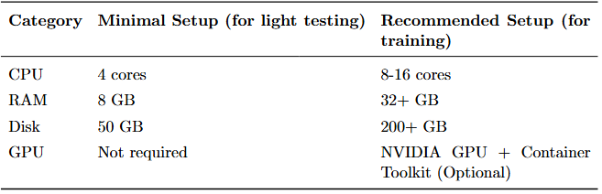
HARDWARE REQUIREMENTS
The project was developed and tested under the following technical configurations. Two separate setups were considered: a minimal environment suitable for light testing and development, and a recommended environment optimized for training, performance evaluation, and large-scale experiments.

Slide 25
SOFTWARE REQUIREMENTS
• Docker: Docker was used to containerize all the microservices, essentially we used 11 microservices and each of them were containerized by writing a docker file. It basically just packs the environment , commands etc which are used by each microservice.
• Kubernetes (k3d/kubectl/Helm): Kubernetes are used to deploy those containers. It also has a load balancer. It runs the containers as pods, and these pods are increased or decreased as required .
• Python (PyTorch): a python library which is used to train the RL models. It trains models using the GPU and on our team, we had 2 RTX 4050s, an RTX 3050 .
• Locust: To check how well things held up, we used Locust – It simulates large numbers of concurrent users and API requests, allowing the system’s behavior under heavy load to be analyzed. The results from Locust testing revealed performance bottlenecks, latency spikes, and scalability limits.
• Prometheus: Prometheus gives the metrics via an endpoint which is in our site. This metrics is then used for visualization by grafana, metrics like the CPU load, memory required and network bytes received or transmitted.

Slide 26
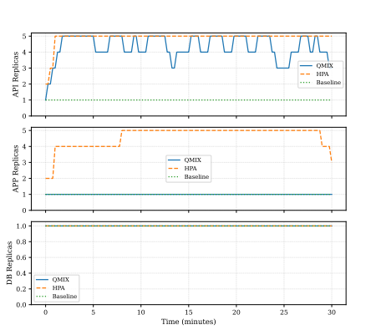
RESULTS AND DISCUSSION
AURA achieves 46% lower API latency (from experiments)
Uses less CPU than HPA (~55% reduction)
Demonstrates predictive and coordinated scaling
Improves SLA performance under dynamic load

Slide 27
CONCLUSION
This project basically proved that AURA works. It’s a fresh take on autoscaling, fixing a lot of the issues that pop up in how modern apps handle scaling. Instead of the usual single-metric setup like HPA which only reacts to its own stuff our design uses a cooperative multi-agent reinforcement learning (MARL) setup, where every microservice acts as its own agent. Each one makes decisions on its own but still works together using a teamwork-based learning approach. The system actually learns how different services affect each other, which is usually where slowdowns and wasted resources happen. We used QMIX with a Centralized Training and Decentralized Execution (CTDE) setup, and built a realistic simulator that captures real-world stuff like startup delays and data lag. That way, whatever we trained in simulation actually worked well when tested live. Plus, by focusing on stability, performance, and cost-effectiveness with a new reward system, we got strategies that are both solid and reliable. Testing AURA in a Kubernetes environment (built using k3d, with Prometheus and Locust)showed that this collaborative approach performs way better than HPA. Beyond just solving current problems, this project sets a base for what comes next like maybe using GNNs to map out how services connect, or letting the agent handle vertical scaling too.

Slide 28
FUTURE SCOPE
Integration of Graph Neural Networks (GNNs) for Dependency Awareness Future versions can incorporate GNNs to explicitly model inter-service dependencies, enabling agents to make more context-aware and globally optimized scaling decisions instead of implicit learning.
Extension to Multi-Dimensional Scaling (Horizontal + Vertical + Placement) Currently focused on horizontal scaling, AURA can be extended to jointly optimize CPU/memory allocation (vertical scaling) and intelligent pod placement, improving overall resource efficiency and reducing fragmentation.
Real-World Production Deployment & Continuous Learning Deploying AURA in real cloud environments with continuous online learning can help bridge the sim-to-real gap, allowing agents to adapt dynamically to unpredictable real-world workloads and traffic patterns.
Incorporation of Predictive & Meta-Learning Techniques Integrating workload prediction models and meta-learning can enable faster adaptation to new applications and traffic behaviors, reducing training time and improving generalization across different microservice architectures.

Slide 29
REFERENCES
A. Gogineni, “Optimizing Resource Management in Kubernetes: A Study of Auto-Scalingand Load Balancing Approaches,” International Journal, vol. 7, no. 11, pp. 241, 2024.ISSN: 2348-9510.
M.-N. Tran, D.-D. Vu, and Y. Kim, “A Survey of Autoscaling in Kubernetes,” Proc. ofthe 2022 Thirteenth International Conference on Ubiquitous and Future Networks (ICUFN),2022.
X. Zhao, C. Wu, Z. Zheng, Z. Li, and J. Liu, “A Hierarchical Reinforcement Learning-basedAutoscaler for Microservices in Kubernetes,” IEEE Transactions on Network and ServiceManagement, vol. 19, no. 4, pp. 4668–4683, Dec. 2022.
Boden, G., et al. (2023). Kube-Knots: A GNN-based Approach for Microservices Autoscal-ing.
Tabish Rashid, Mikayel Samvelyan, Christian Schroeder de Witt, Gregory Farquhar, JakobFoerster, Shimon Whiteson, ”QMIX: Monotonic Value Function Factorisation for Deep Multi-Agent Reinforcement Learning”, Proceedings of the 35th International Conference on MachineLearning (PMLR), Vol. 80, pp. 4295–4304, 2018.
Autonomous Upscaling Reinforcement Agents

Slide 30
REFERENCES
Ryan Lowe, Yi Wu, Aviv Tamar, Jean Harb, Pieter Abbeel, Igor Mordatch, ”Multi-Agent Actor-Critic for Mixed Cooperative-Competitive Environments”, Advances in Neural Information Processing Systems (NeurIPS), Vol. —, pp. 6382–6393, 2017.
Haoran Qiu, et al., ”AWARE: Automate Workload Autoscaling with Reinforcement Learningin Production Cloud Systems”, Proceedings of the 2023 USENIX Annual Technical Conference (USENIX ATC 2023), Vol. —, pp. —, 2023.
M. Xu, et al., ”CoScal: Multi-faceted Scaling of Microservices with Reinforcement Learning”, IEEE Transactions on Network and Service Management (or conference proceedings listed inacceptance), Vol. 19, pp. 3995–(end), 2022.
Majid Ghasemi, Dariush Ebrahimi, ”Introduction to Reinforcement Learning”, arXiv preprintarXiv:2408.07712v3 [cs.AI], Department of Computer Science, Wilfrid Laurier University, Waterloo, Canada, December 2024.
Autonomous Upscaling Reinforcement Agents

Slide 31
Thank You!
Notes:
25

